Slide 1
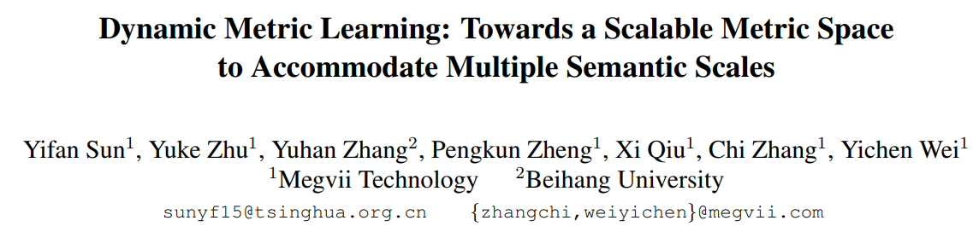
CVPR 2021
Jeonbuk National University, Korea
Multimedia Lab Under Prof. Park and Prof. Yoon
Mingle Xu
2021 May 28

Slide 2
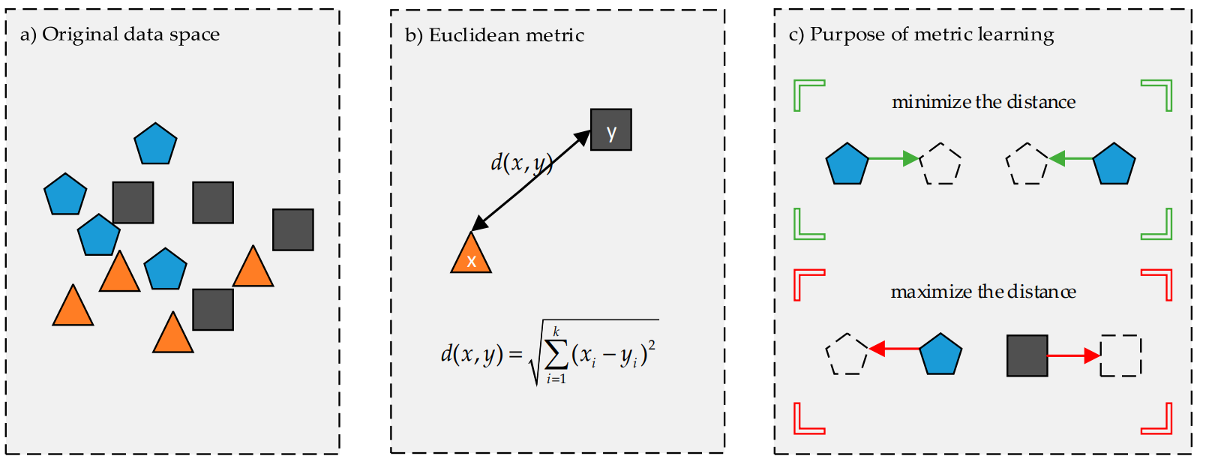
Background: What is Metric Learning?
Metric learning aims to measure the similarity among samples while using an optimal distance metric for learning tasks. (Kaya, Mahmut, and Hasan Şakir Bilge. "Deep metric learning: A survey." Symmetry 11.9 (2019): 1066.)

Slide 3
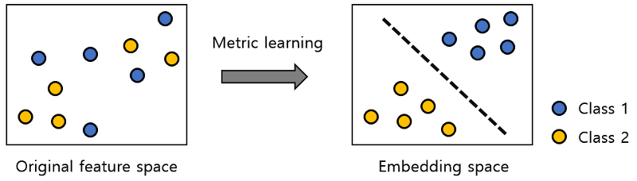
Background: Metric Learning
Metric learning is the task of learning a distance function over objects. (wiki)

Slide 4
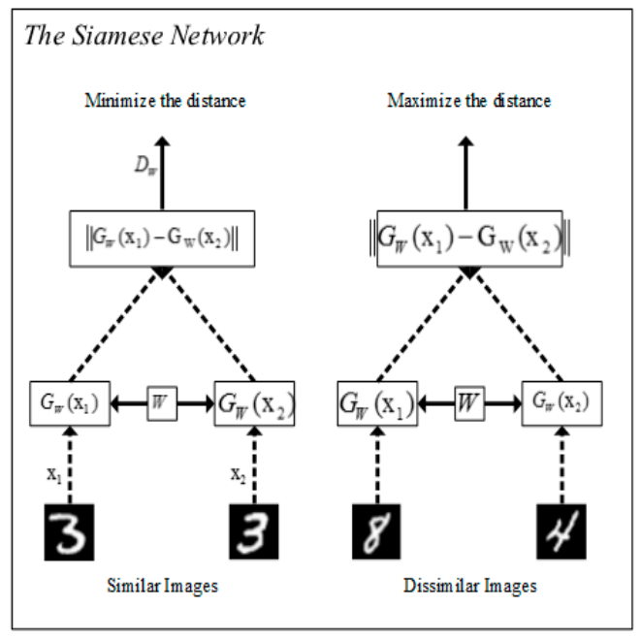
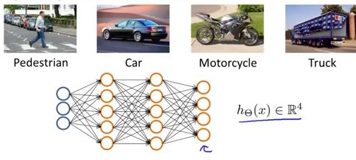
Background: Taxonomy of Metric Learning
Pair-based
Classification-based

Slide 5
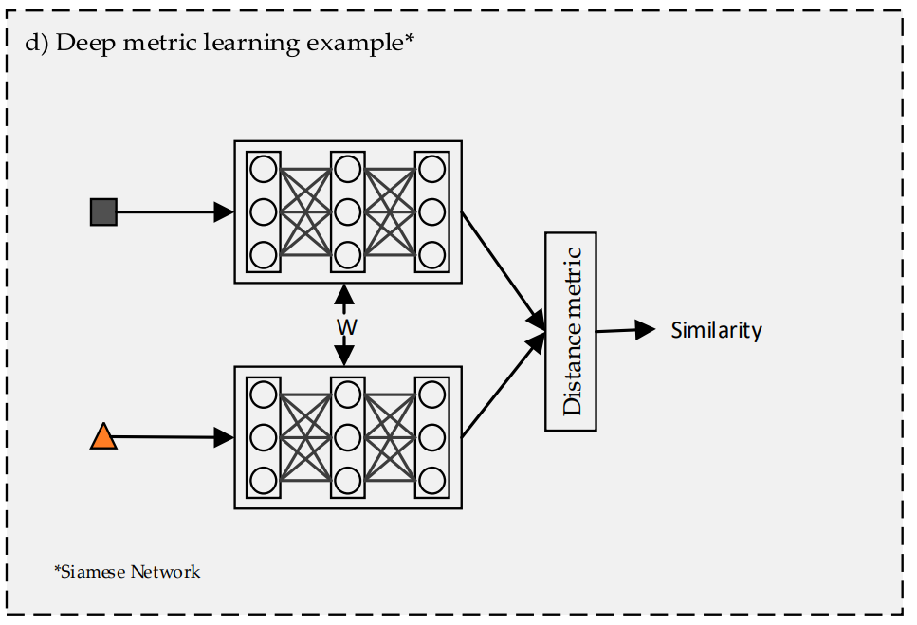
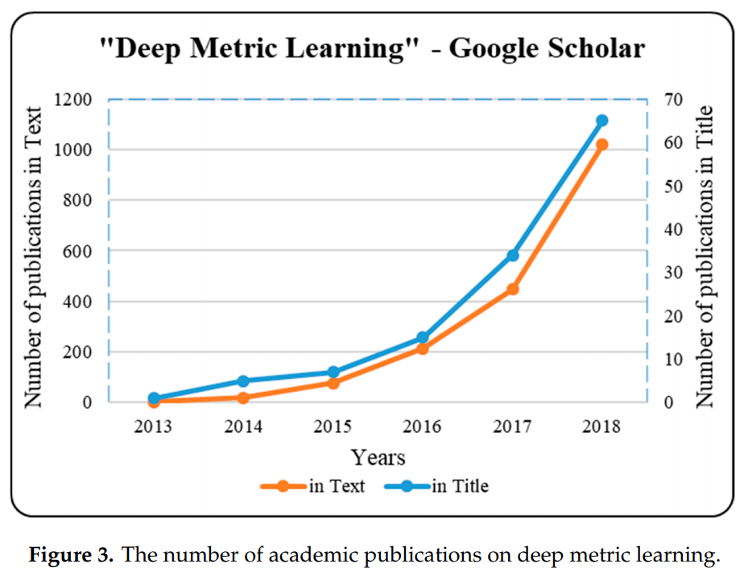
Background: Deep Metric Learning
Classical metric learning is leveraged in raw data.
Deep metric learning employs pre-processing and feature extraction before specific task.

Slide 6
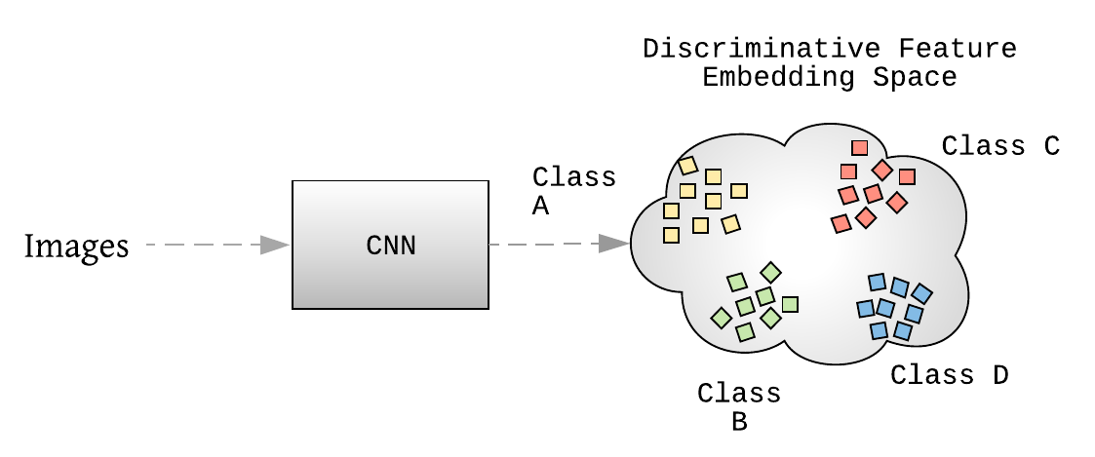
Background: Metric Learning
Metric
Similarity
Distance
Feature extractor
Representation learning
Loss
Metric space
Metric function
Metric domain
CNN is a special metric learning method.

Slide 8
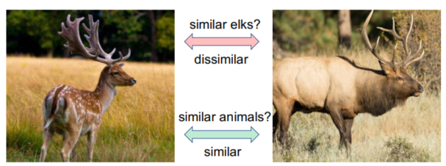
Introduction
Challenge: similarity in different scale.
Dynamic metric learning.

Slide 9
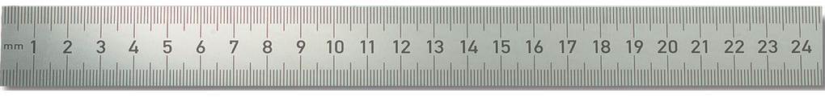
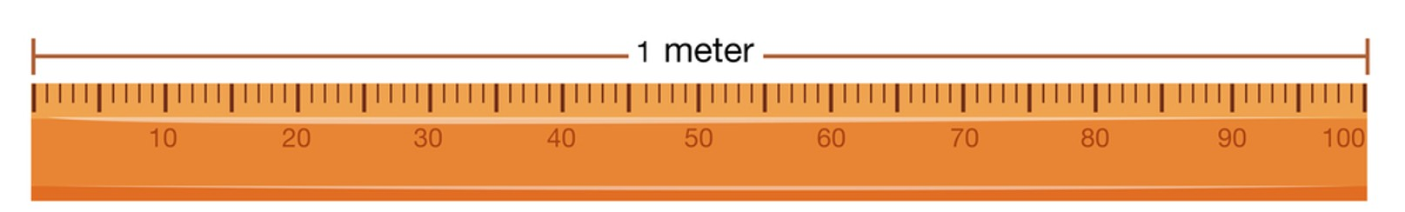
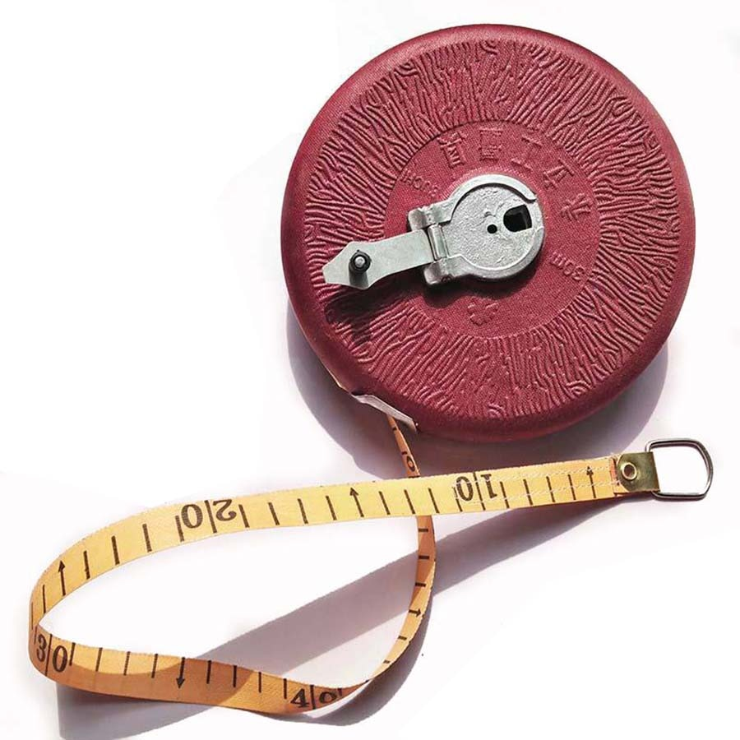
Introduction
Why do we want to have a dynamic metric learning?

Slide 10
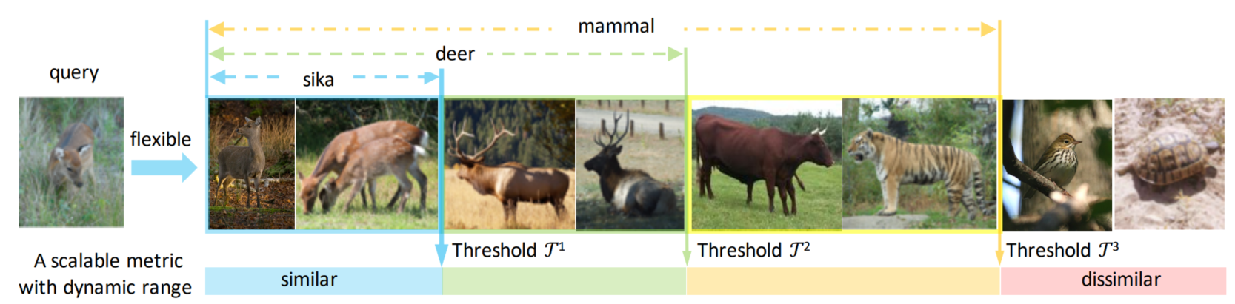
Introduction
Dynamic metric learning is useful when we try to do several tasks at same time with different visual scale.
The major difficulty of single metric lies in a conflict between different scales: the discriminative ability under a small scale usually compromises the discriminative ability under a large one, and vice versa.
One of the applications: image retrieval.

Slide 11
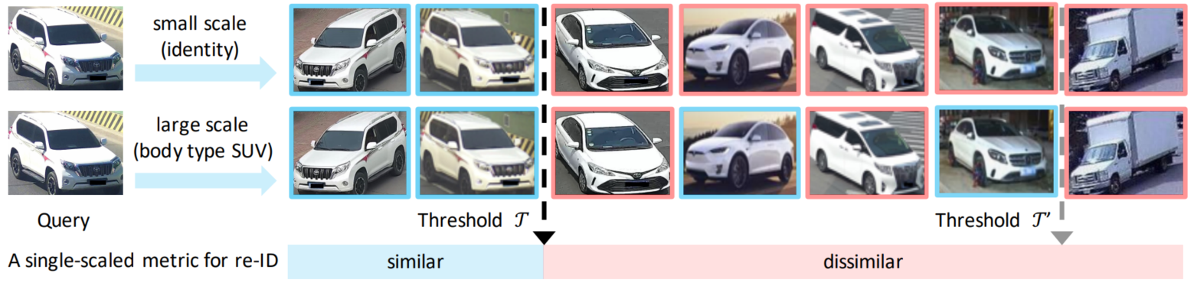
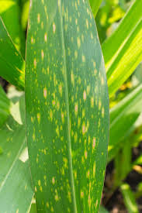
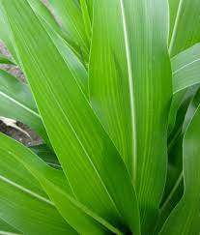
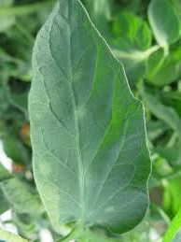
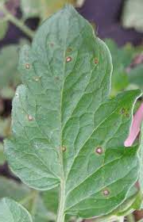
Introduction
Car image retrieval from same identity (type) to same body type.
Another application: hierarchical classification.

Slide 12
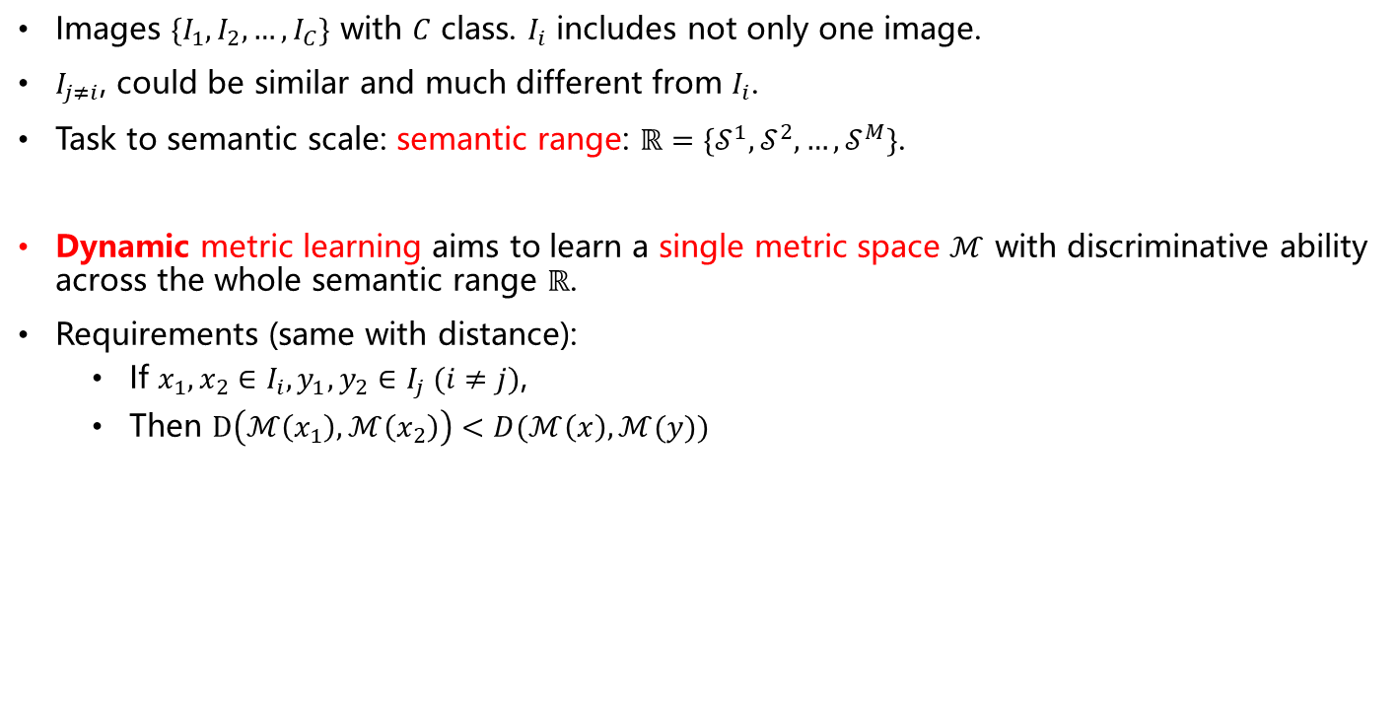
Task Formulation
Images $\{I_{1},I_{2},…,I_{C}\}$ with $C$ class. $I_{i}$ includes not only one image.
$I_{j≠i}$, could be similar and much different from $I_{i}$.
Task to semantic scale: semantic range: $ℝ=\{𝒮^{1},𝒮^{2},…,𝒮^{M}\}$.
Dynamic metric learning aims to learn a single metric space $ℳ$ with discriminative ability across the whole semantic range $ℝ$.
Requirements (same with distance):
If $x_{1},x_{2}∈I_{i}, y_{1},y_{2}∈I_{j} (i≠j)$,
Then $D\left(ℳ\left(x_{1}\right),ℳ\left(x_{2}\right)\right)<D(ℳ\left(x\right),ℳ(y))$

Slide 13
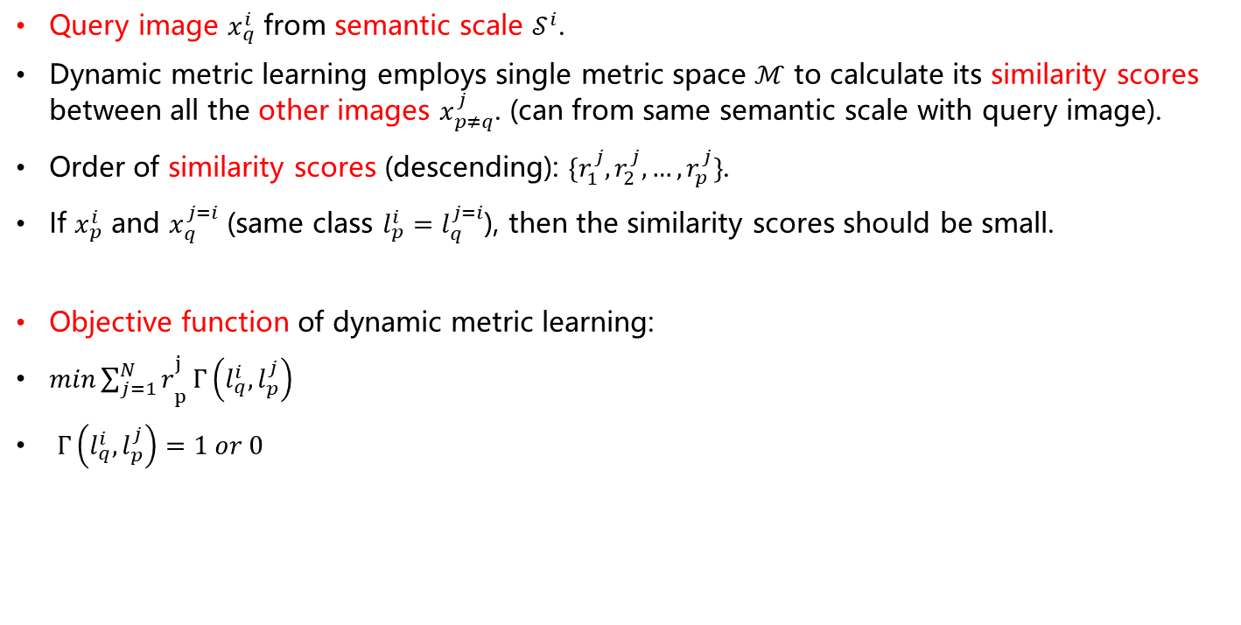
Task Formulation in Image Retrieval
Query image $x_{q}^{i}$ from semantic scale $𝒮^{i}$.
Dynamic metric learning employs single metric space $ℳ$ to calculate its similarity scores between all the other images $x_{p≠q}^{j}$. (can from same semantic scale with query image).
Order of similarity scores (descending): $\{r_{1}^{j},r_{2}^{j},…,r_{p}^{j}\}$.
If $x_{p}^{i}$ and $x_{q}^{j=i}$ (same class $l_{p}^{i}=l_{q}^{j=i}$), then the similarity scores should be small.
Objective function of dynamic metric learning:
$min{\sum_{j=1}^{N}{r}}_{p}^{j}Γ\left(l_{q}^{i},l_{p}^{j}\right)$
$Γ\left(l_{q}^{i},l_{p}^{j}\right)=1 or 0$

Slide 14
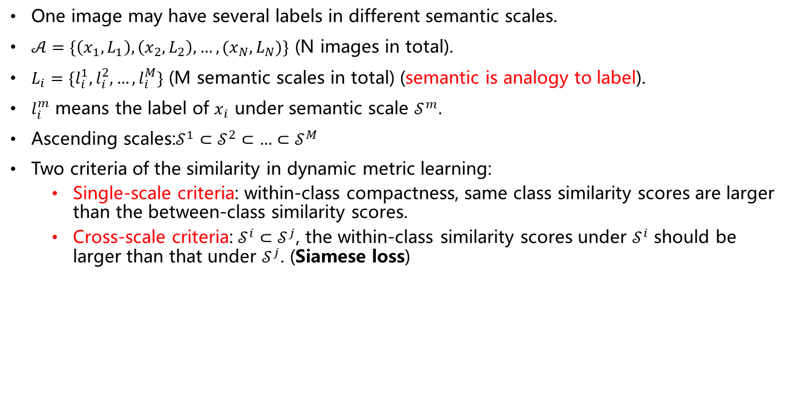
Task Formulation with Hierarchical Annotations
One image may have several labels in different semantic scales.
$𝒜=\{\left(x_{1},L_{1}\right),\left(x_{2},L_{2}\right),…,(x_{N},L_{N})\}$ (N images in total).
$L_{i}=\{l_{i}^{1},l_{i}^{2},…,l_{i}^{M}\}$ (M semantic scales in total) (semantic is analogy to label).
$l_{i}^{m}$ means the label of $x_{i}$ under semantic scale $𝒮^{m}$.
Ascending scales:$𝒮^{1}⊂𝒮^{2}⊂{…⊂𝒮}^{M}$
Two criteria of the similarity in dynamic metric learning:
Single-scale criteria: within-class compactness, same class similarity scores are larger than the between-class similarity scores.
Cross-scale criteria: $𝒮^{i}⊂𝒮^{j}$, the within-class similarity scores under $𝒮^{i}$ should be larger than that under $𝒮^{j}$. (Siamese loss)

Slide 15
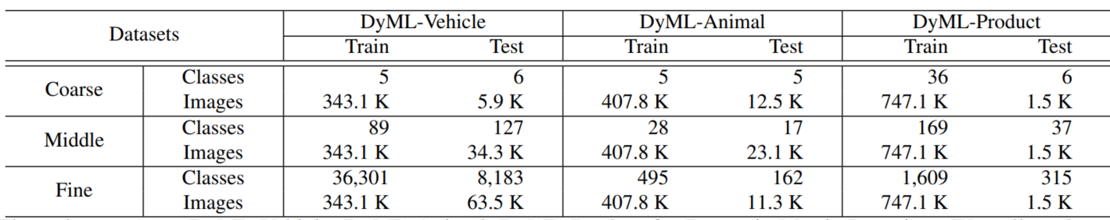
Datasets
Common properties:
Three hierarchical levels of labelling. Every level has several classes.
Abundant semantic scales: not only three levels. Some semantic scales include several levels. For example, phylum, class, order, family, genus.
No class intersections between training and testing set: the testing classes are novel to training classes (but not for the coarse level).
Three datasets

Slide 16
Datasets
Vehicle:
Identity
Model, Toyota Camry, Honda Accord, Audi A4, …
Body, car, suv, microbus, pickup, …
Taxi as a novel testing class.
Animal (from ImageNet-5K):
Species
Order, family, genus
Classes
Product (from iMaterialist-2019):

Slide 17
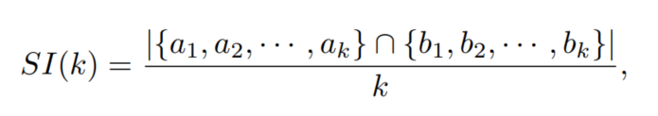
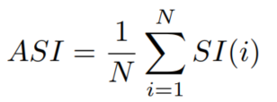

Evaluation Protocol
From image retrieval
Mean Average Precision (mAP) considers both precision and recall.
Cumulated Matching Characteristics (CMC) indicates the probability that a true match exists in the top-K sorted list. (top-k accuracy).
ASI (average set intersection) evaluates the similarity of two ranking list (mIoU).
Two ranking list $A=\left\{a_{1},a_{2},…,a_{N}\right\}$ and $B\{b_{1},b_{2},…,b_{N}\}$
Depth k

Slide 18
Compared Methods
Baselines with three steps:
Framework: backbone to get feature
Then use one of current loss function, softmax, triplet loss and so on.
Sum up the losses on all the semantic scales in the multi-task learning manner.
Backbone
Loss
Sum on scales

Slide 19
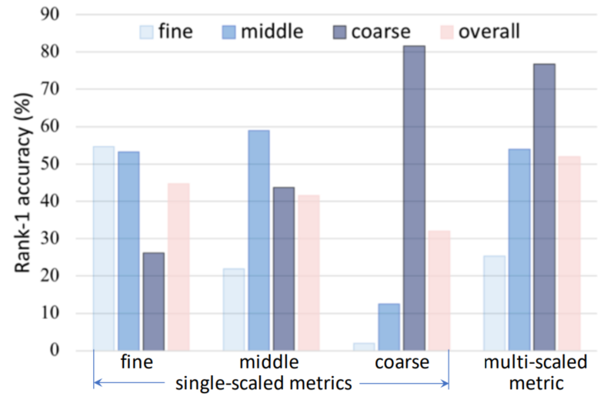
The baseline is better than single scale.
But there are conflicts between different scales.
Three observations
Single for itself
Single for other scale
Multi-scale
Why is the conflict?

Slide 20
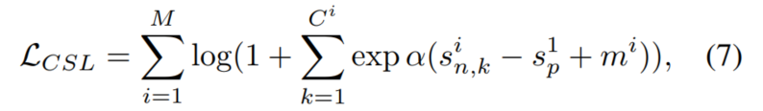

Proposed Method: CSL cross-scale learning
Within-class similarity $s_{p}^{i}$ and between-class similarity $s_{n}^{i}$ under scale $𝒮^{i}$
A smaller scale, say $𝒮^{1}$
Reference similarity: $s_{p}^{1}≥s_{n}^{i}+m^{i}$
$m^{i}$ is the similarity margin
$m^{1}≤m^{2}≤…≤m^{M}$
Final CSL loss:

Slide 21
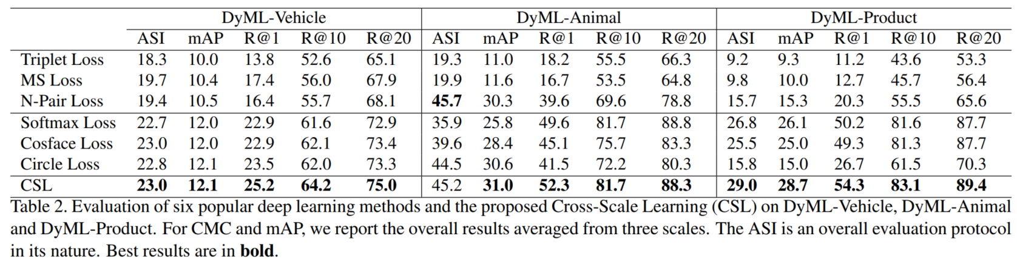
Experiments: Comparison
Three observations
All are low
Paired vs classification-based
Classification-based and dynamic metric learning

Slide 22
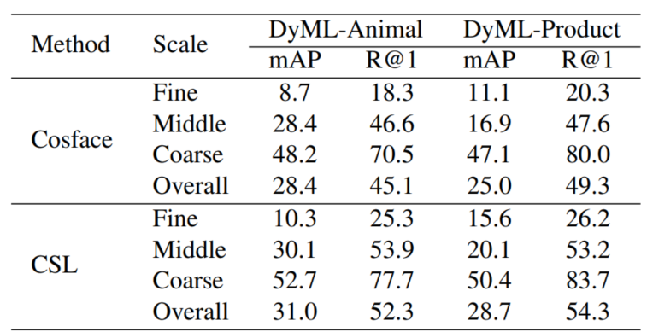
Experiment: multi-scale
Their observation
CSL is better in all scales than Cosface
My observation
For the both methods, coarse is better than middle, middle is better than fine.
Can we say all of them are biased on the coarse?
Just ease the conflict, not eliminate.

Slide 23
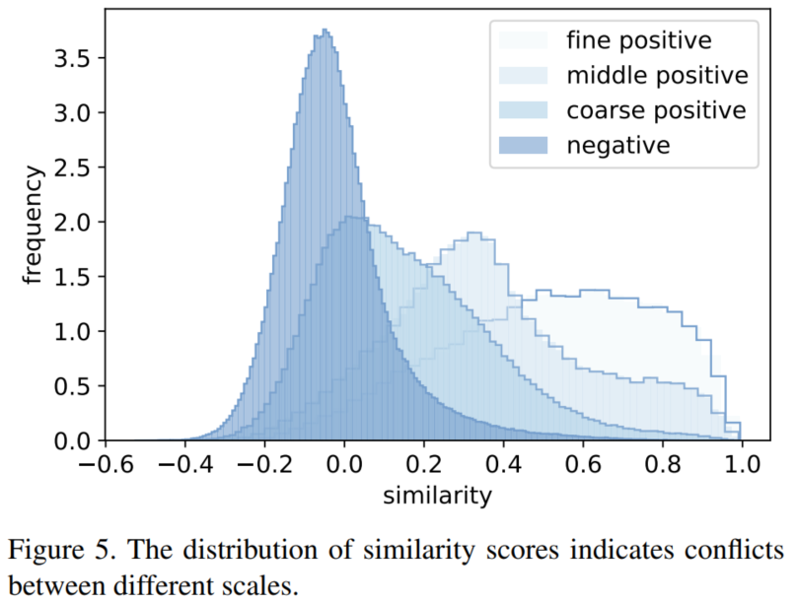
Experiment: Conflicts on Multi-Scale Training

Slide 24
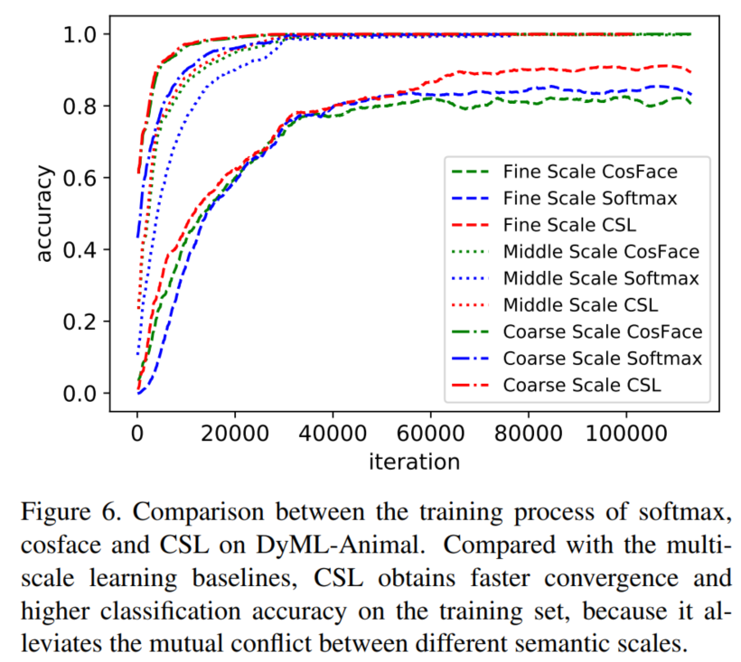
Experiment: the Superiority of CSL

Slide 25
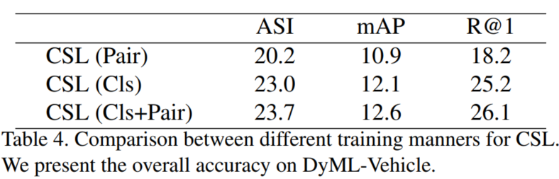
Experiment: Compatibility of CSL

Slide 26
Discussion and Conclusion
This paper:
New problem, dynamic metric learning
New method: CSL, cross-scale learning
Limitations
Detail annotations for training, deep metric learning does not require this.
The scale conflict still exists and CSL just mitigate it.
In CSL, semantic scale = class scale. So in same level, it does nothing.
Only for image retrieval, can we use it for other tasks?

